Slide 2
Mortgage Revenue Bond Program
Forms

Slide 3
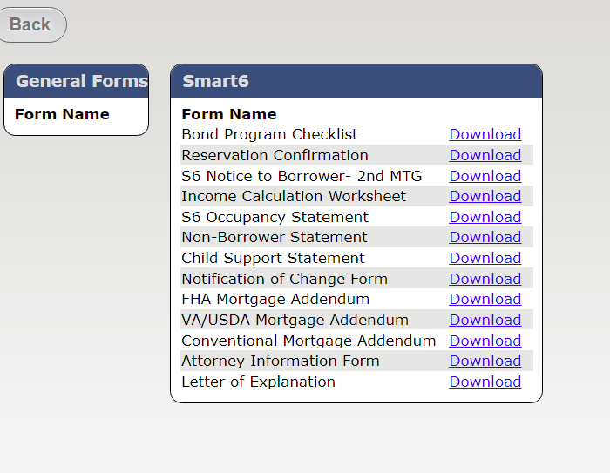
Note: Only forms specific to the program type will be available

Slide 4
Updated Bond Checklist

Slide 5
Updated Attorney Information Form

Slide 6
Notification of Change Form Must be signed by lender

Slide 7
Notice to Borrower *this is specific to the program being utilized Borrower needs to sign and date

Slide 8
Income Calculation Worksheet Annual family income must match Borrower Certification

Slide 9
Borrower Certification Annual family income must match Income Calculation Worksheet

Slide 10
Child Support Statement Required for ALL Mortgage Revenue Bond Products *Always provide supporting documentation (i.e. Divorce Decree or MHC LOE

Slide 11
Occupancy Statement Smart6 ONLY *Always provide supporting documentation (i.e. Divorce Decree or MHC LOE

Slide 12
Non-Borrower Statement Should be used for ALL bond products anytime there is a non-borrower

Slide 13
Letter of Explanation Can be electronically signed

